Slide 1
Samyukta Maharashtra Parishad
A meeting of 'Maharashtra Ekikaran Parishad' was held in Mumbai on 28th July.
The president of the meeting was Shankarrao Dev.
A resolution was passed to include all Marathi-speaking regions into one state.
This would include regions like Mumbai, Central provinces, Marathwada, and Gomantak.

Slide 2
Maharashtra Ekikaran Parishad (Extra Information)
The Maharashtra Ekikaran Parishad was a political organization in India that was active in the 1950s and 1960s. The main objective of the organization was to merge all Marathi-speaking regions of India into a single state. The organization was founded in 1948 by the prominent Marathi writer Keshavrao Jedhe, and its first president was Shankarrao Deo. The Parishad organized various agitations and protests to achieve its goal, including the famous Samyukta Maharashtra Movement in the late 1950s. The movement eventually led to the formation of the state of Maharashtra in 1960, which included the former Bombay State and other Marathi-speaking areas.

Slide 3
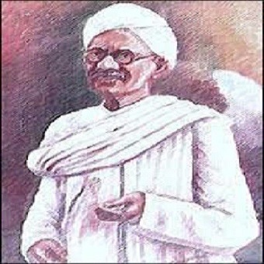
Shankarrao Dev (Extra Information)
Shankarrao Dev (1901-1974) was an Indian independence activist and politician from Maharashtra. He was a strong proponent of the Samyukta Maharashtra Movement, which advocated for the unification of all Marathi-speaking regions under one state. He played an instrumental role in the formation of Maharashtra state on May 1, 1960, and served as the state's first chief minister from 1960 to 1962. Dev was also a member of the Constituent Assembly of India and played a key role in drafting the Indian Constitution. He was a recipient of the Padma Vibhushan, India's second-highest civilian award.

Slide 4
Dar Commission
The Dar Commission was established on 17 June 1948 by Dr. Rajendra Prasad, who was the President of Constituent Assembly.
The purpose of the commission was to form linguistic provinces.
The commission was chaired by Justice S.K. Dar.
The report of the Dar Commission was published on 10 December 1948.
However, despite the publication of the report, the issue of forming linguistic provinces remained unsolved.

Slide 5
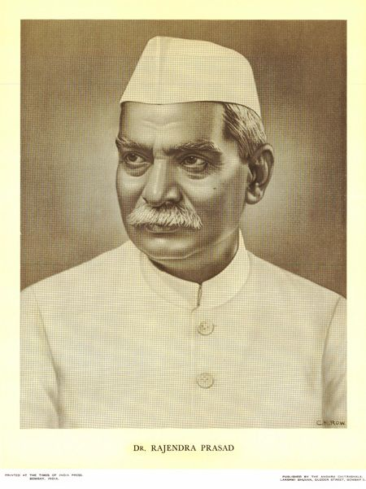
Dr. Rajendra Prasad (Extra Information)
Dr. Rajendra Prasad (1884-1963) was an Indian independence activist, lawyer, and politician who served as the first President of India from 1950 to 1962. He was born in Bihar and obtained his education in Calcutta and England. Dr. Prasad actively participated in the Indian freedom struggle, and was associated with the Indian National Congress. He was a supporter of Mahatma Gandhi and was imprisoned several times during the struggle for independence. After India became independent, Dr. Prasad was appointed as the President of the Constituent Assembly, which drafted the Indian Constitution. He went on to become the first President of India after the adoption of the Constitution. As President, he was known for his simplicity and integrity, and played an important role in consolidating the newly independent India. He was also awarded the Bharat Ratna, India's highest civilian award, in 1962.

